Slide 1
“Online Food Delivery System”
Nusrath Naznin Atoshi - 17201105
Md. Najmul Islam Sunny -17201004
Anik Kumar Sikder- 17201068

Slide 2
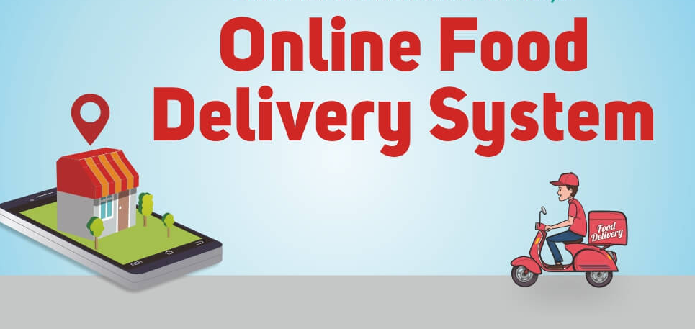
Project Title: Online Food Delivery System

Slide 3
Motivation:
We are currently living in a very critical situation. Because of the Corona pandemic, everyone has to stay in quarantine at home. As a result, we are all at home and we can not go to the restaurants even if we want . So we have to order food from online food delivery systems. As a result, the top motivation for ordering-in food was mainly for a change in taste and the need to cheer up .In this COVID situation if we go out ,we can be affected. As a result, our family members will also be affected so ordering food through an online food delivery system is the best way. With such an environment in mind, we plan to do something that will help people to get their food at home with proper safety and delicious food. So we started thinking about an online food delivery system which is effective for time saving and also good for the current COVID situation. By doing this, People will get their food at home with proper safety and hygiene.

Slide 4
Problem Definition:
In a modern generation Online food ordering is a mobility of food delivery or takeout from a local restaurant or food cooperative. Now days the rapid growth in the use of internet and the technologies associated with it, the several opportunities are coming up on the web or mobile application. This is made possible through the use of electronic payment system. The payment can be done through the customer’s credit card, debit card. It is possible for everyone to order any goods from anywhere the internet and have the goods delivered at his/her home. All types made be internet le transaction ads to the economic of digital cash, the necessary tool for this process telecommunication with customers. The system will become an important tools use for restaurant to improve the management aspect by use of computer system to connected each and every food ordering transaction instead of data record on it. In addition, it can also provide efficiency for the restaurant by reducing time consuming, minimize human errors or delivery and providing good quality and service to customers. In terms of the integrity and availability of the system provided, it can be concluded that this system is a suitable solution.

Slide 5
Objective, Solution & Project Outputs:
Enhance the quality of the security system.
People can trust our site as we are ensuring Reliability .
Ordering food online saves time.
We ensure customer satisfaction.
Communication build-up with clients.
Bill problem is not an issue.
Interactive and up-to-date menu.
Well-designed self-service ordering systems.
Credit point and discount coupon System.
People can order through own online web or mobile site.

Slide 6
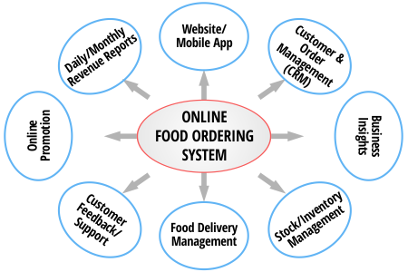
Online food delivery system design:

Slide 7
Security System:
Sign-up.
Log-in.
OTP Verification Code.

Slide 8
Impact on Society:
Easy communicative
Time saving
Delivery place
Always open restaurant
Payment

Slide 9
Critical challenges:
After working and analyzing it we realized that we are going to face a lot of challenges. Those critical challenges can be:
● Security issues - When it comes to E-commerce, one of the biggest challenges faced is security breaches. There is a lot of information/data that is involved while dealing with E-commerce and a technical issue with data can cause severe damage to the retailer’s daily operations as well as brand image.
● Customer Experience - Customer experience or user experience is key to a successful E-commerce website. To build up our website we need a huge amount of data and those should be premium quality, which is difficult to collect. We have to build our website as user friendly.
● User Credential - Every customer should have a user account , without it he/she can’t order food. We have to keep their information very secret so that no one gets it.

Slide 10
Conflicting requirement:
For getting accurate results from websites we need to verify all data before adding any food. It must be genuine food and not to be copied from any other websites or other platforms. Without this verification may create conflict. Situations to get better results.

Slide 11
How P and K s are addressed through the project and mapping:
Ps | Attribute | How Ps are addressed through the project
P1 | Depth of Knowledge Requirement | Engineering design (multi-layer model design) (K5) User interface development (K6) knowledge of software engineering (feature extension) (K3, K4).
P2 | Range of Conflicting Requirement | Create a Responsive website so that a User can access from any type of device to get our Online food delivery system..
P5 P7 | Extent of applicable codes Interdependence | We use a proper library so that we can change or implement our website according to user recommendation that would be efficient for users. We want to create OTP Verification code system.

Slide 12
How As are addressed through the project:
As | Attribute | How As are addressed through the project
A1 | Range of Resources | In development stage, the project requires the use of diverse resources including different type of Tools : VS code IDE, Java Script, Technologies: MVC Model, People: developers.
A2 | Level of Interaction | A better interaction is required among the Admins and developers (client), the Moderators and the participants (system users).
A3 | Innovation | A degree of innovation is required to develop the website based on MVC pattern using the available programming language.
A4 | Consequences for society and the environment | Because of this, our virtual interaction is going to become more real. Even in the condition of having physical distance, customers will be able to gain their approximate goal and Moderators also could provide their best services.
A5 | Familiarity | The project deals between customers and moderators understanding based on communication through online food supply to customers.

Slide 13
Project Management (Time-table) and Cost analysis:
Task | Time Duration | Proposed Budget
Project Proposal | 1st week | 65$
Project Requirement Analysis | 2nd week | 30$
UI/UX design | 3rd & 4th week | 85$
Resister sign | 5th week | 45$
Resister sign | 6th week | 40$
Resister sign | 7th week | 30$
Log-in | 8th week | 70$
Backend | 9th & 10th week | 40$
Frontend | 11 & 12th week | 45$
Pre-Submission | 13th week | 50$
Post Submission | 14th week | 75$

Slide 14
THANK YOU

Slide 15
ANY QUESTION ???

